Slide 1
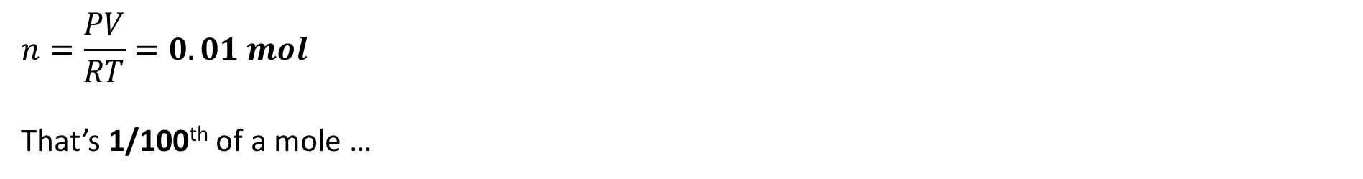
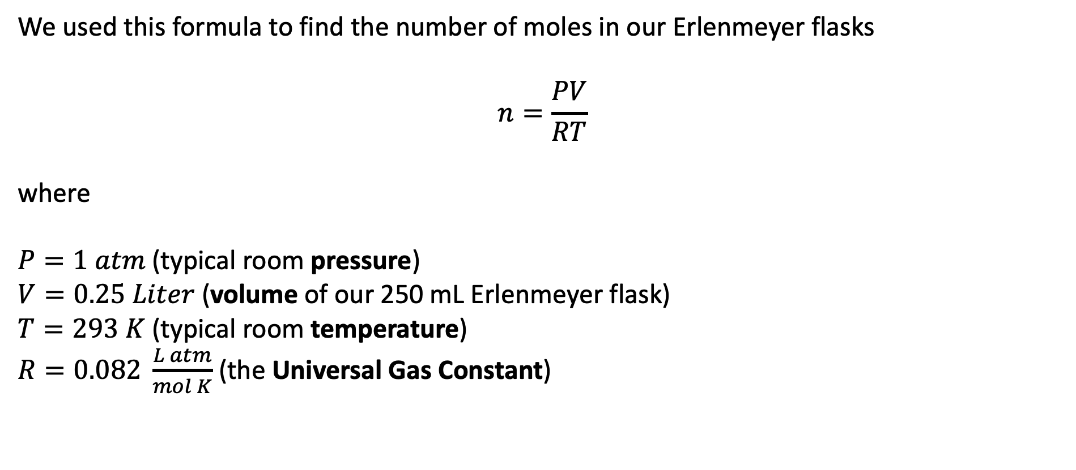
Recap: The Ideal Gas Law
We used this formula to find the number of moles in our Erlenmeyer flasks
$$n=\frac{PV}{RT}$$
where
$P=1 atm$ (typical room pressure)
$V=0.25 Liter$ (volume of our 250 mL Erlenmeyer flask)
$T=293 K$ (typical room temperature)
$R=0.082 \frac{L atm}{mol K}$ (the Universal Gas Constant)
$$n=\frac{PV}{RT}=0.01 mol$$
That’s 1/100th of a mole …

Slide 2
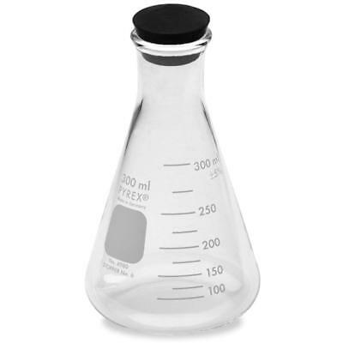
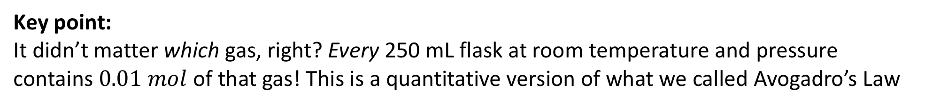



Recap: The Ideal Gas Law
Key point:
It didn’t matter which gas, right? Every 250 mL flask at room temperature and pressure contains $0.01 mol$ of that gas! This is a quantitative version of what we called Avogadro’s Law
$$0.01 mol$$
$$0.01 mol$$
$$0.01 mol$$
H₂(g)
N₂(g)
C₃H₈(g)

Slide 3

Recap: Utility of this idea for identifying an unknown gas
$$0.01 mol$$
Evacuated
Unknown gas
air
If you could figure out how much 0.01 mol of air weighs, then you could figure out how much the evacuated flask weighs (by subtracting the mass of the air). Then, when you get an unknown, you could figure out the mass of the unknown gas!
To move ahead with this, we need the mass-mole equation.

Slide 4
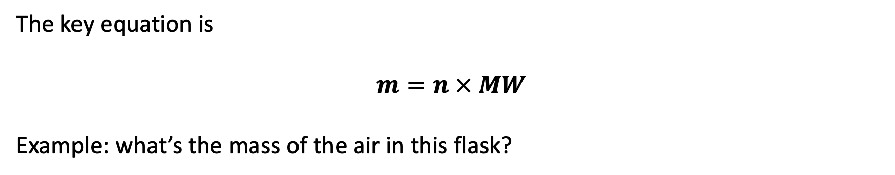
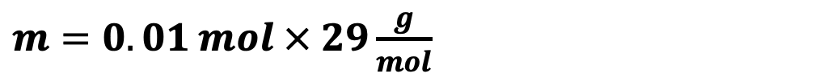
The mass-mole equation
The key equation is
$$m=n × MW$$
Example: what’s the mass of the air in this flask?
$m=0.01 mol × 29\frac{g}{mol}$
$$0.01 mol$$
air

Slide 5
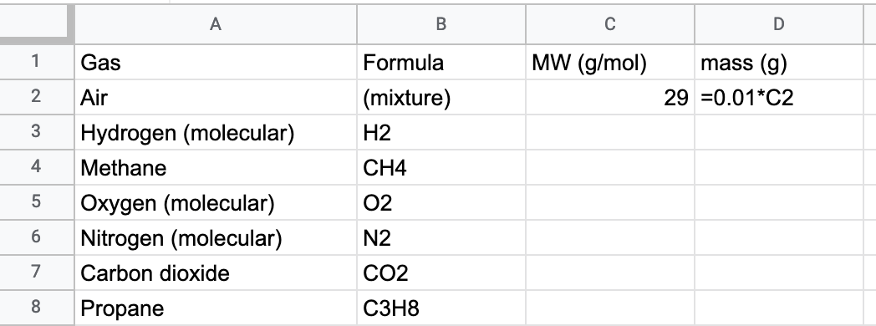

The mass-mole equation
The key equation is
$$m=n × MW$$
Example: what’s the mass of the air in this flask?
$m=0.01 mol × 29\frac{g}{mol}$
$$0.01 mol$$
air

Slide 6
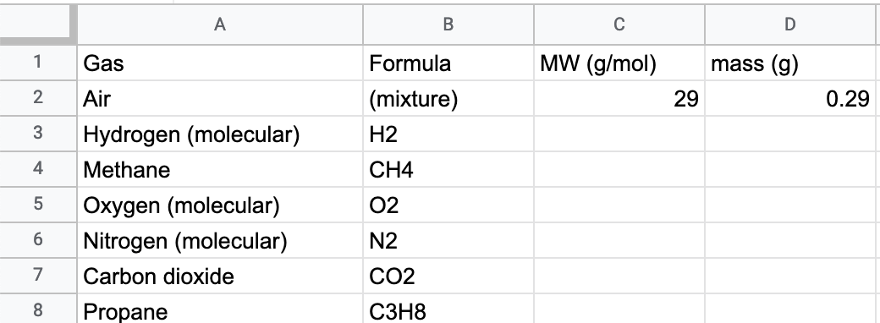
The mass-mole equation
The key equation is
$$m=n × MW$$
Example: what’s the mass of the air in this flask?
$m=0.01 mol × 29\frac{g}{mol}$
$$0.01 mol$$
air

Slide 7
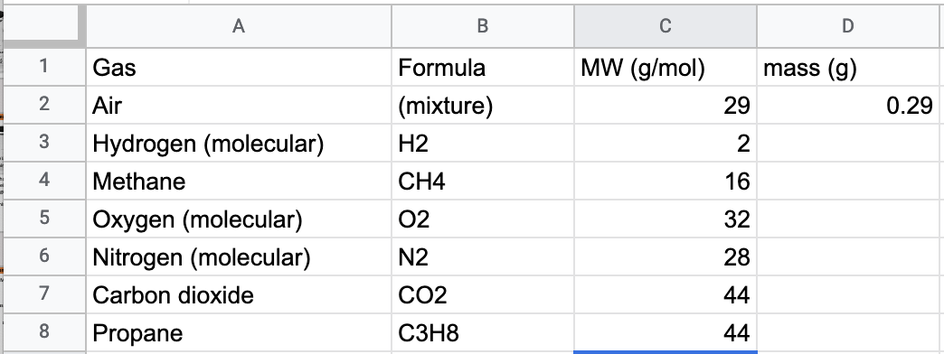
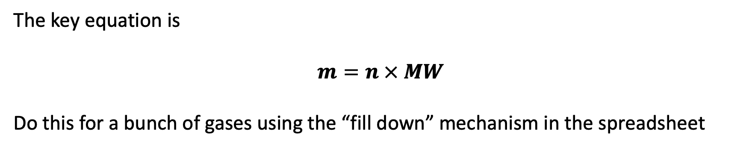
The mass-mole equation
The key equation is
$$m=n × MW$$
Do this for a bunch of gases using the “fill down” mechanism in the spreadsheet
$$0.01 mol$$
air

Slide 8
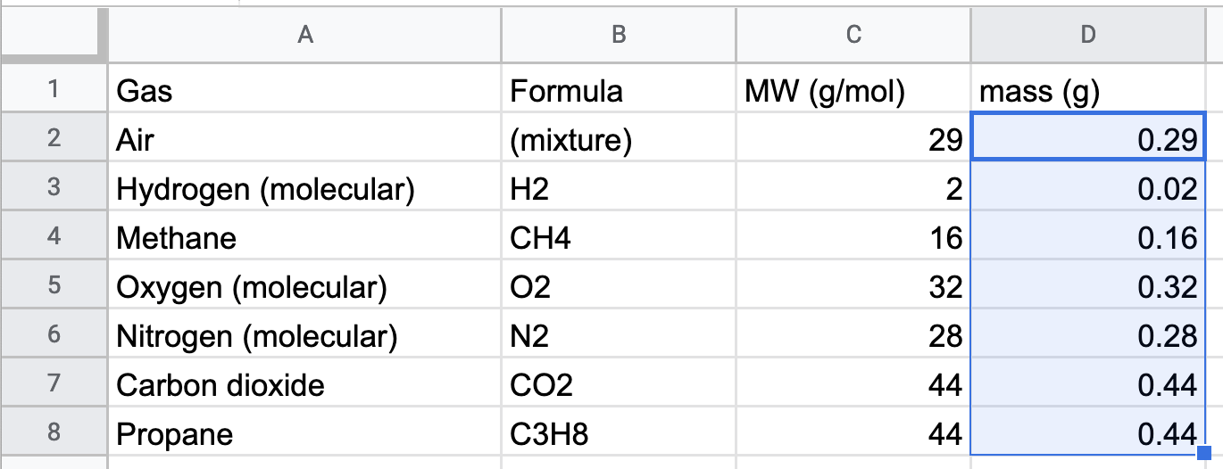
The mass-mole equation
The key equation is
$$m=n × MW$$
Do this for a bunch of gases using the “fill down” mechanism in the spreadsheet
$$0.01 mol$$
air

Slide 9
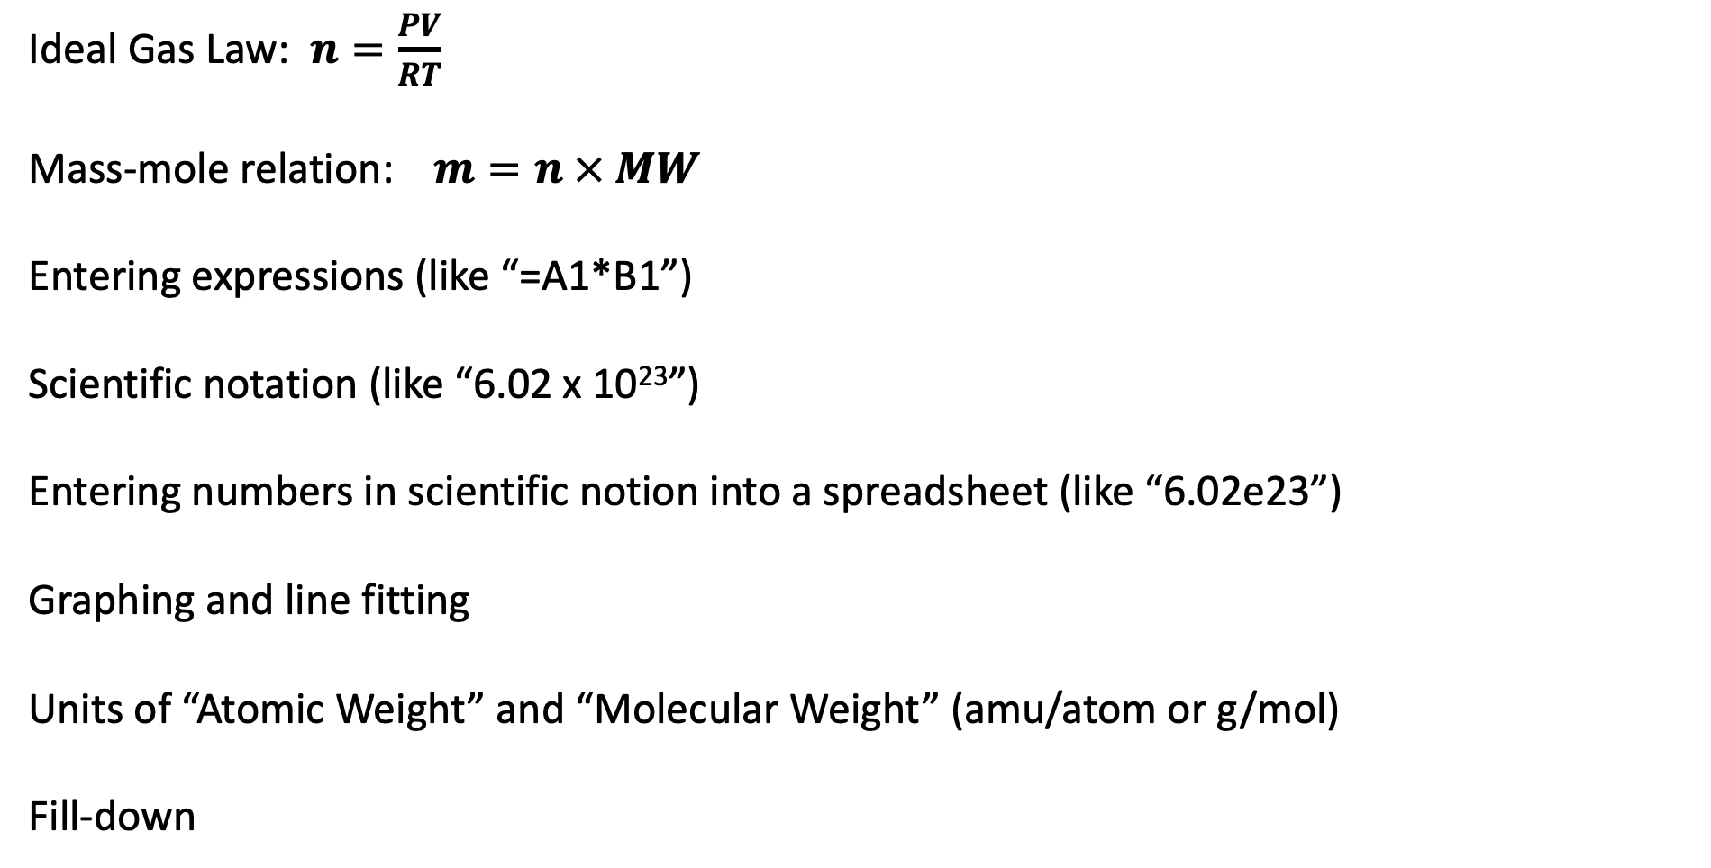
Summary of key equations and spreadsheet skills
Ideal Gas Law: $n=\frac{PV}{RT}$
Mass-mole relation: $m=n × MW$
Entering expressions (like “=A1*B1”)
Scientific notation (like “6.02 x 10²³”)
Entering numbers in scientific notion into a spreadsheet (like “6.02e23”)
Graphing and line fitting
Units of “Atomic Weight” and “Molecular Weight” (amu/atom or g/mol)
Fill-down

Slide 10
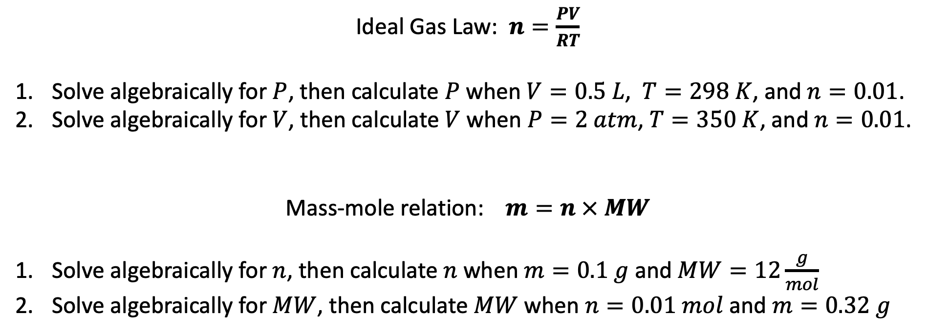
Practicing in your spreadsheet …
Ideal Gas Law: $n=\frac{PV}{RT}$
Solve algebraically for $P$, then calculate $P$ when $V=0.5 L$, $T=298 K$, and $n=0.01$.
Solve algebraically for $V$, then calculate $V$ when $P=2 atm$, $T=350 K$, and $n=0.01$.
Mass-mole relation: $m=n × MW$
Solve algebraically for $n$, then calculate $n$ when $m=0.1 g$ and $MW=12\frac{g}{mol}$
Solve algebraically for $MW$, then calculate $MW$ when $n=0.01 mol$ and $m=0.32 g$

